Slide 1
STOCK MARKET
Tracker
An API based stock price tracker.
Nutan College of Engineering and Research
Presented by: Team Brokers

Slide 2
Agenda
Introduction
Objectives
Technology Stack
Key Features
User Interface Preview
Real World Application
Future Scope
Conclusion

Slide 3

Introduction
In today’s fast-paced financial world, understanding the stock market can be overwhelming for beginners.
Our project- Stock Market Tracker — is designed to simplify the journey into investing.
With a clean interface and simulated trading features, we aim to make stock market tracking both accessible and informative for new users.

Slide 4

Objectives
Simplify the process of tracking stock prices
Educate users about basic stock market concepts
Provide an intuitive interface for beginners
Encourage financial literacy among students and
first-time investors

Slide 5
Technology Stack
Frontend: HTML, CSS, JavaScript
Backend: API integration (Financial data from static
or demo sources) , chart.js
Styling Theme: Inspired by real stock market
dashboards (groww).
APIs: multiple finance APIs along with the data
Tools Used: VS Code, GitHub, web browser for
testing

Slide 6
Key Features
Introduction
Objectives
Technology Stack
Key Features
User Interface Preview
Real World Application
Future Scope
Conclusion

Slide 7
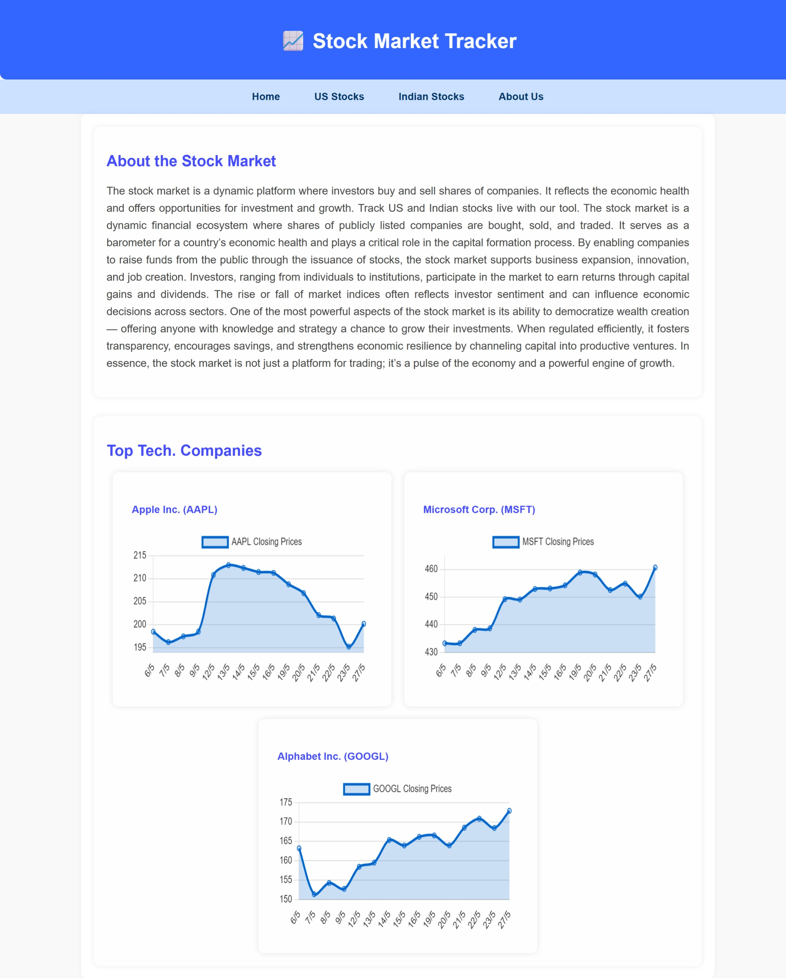
USER Interface Preview

Slide 8
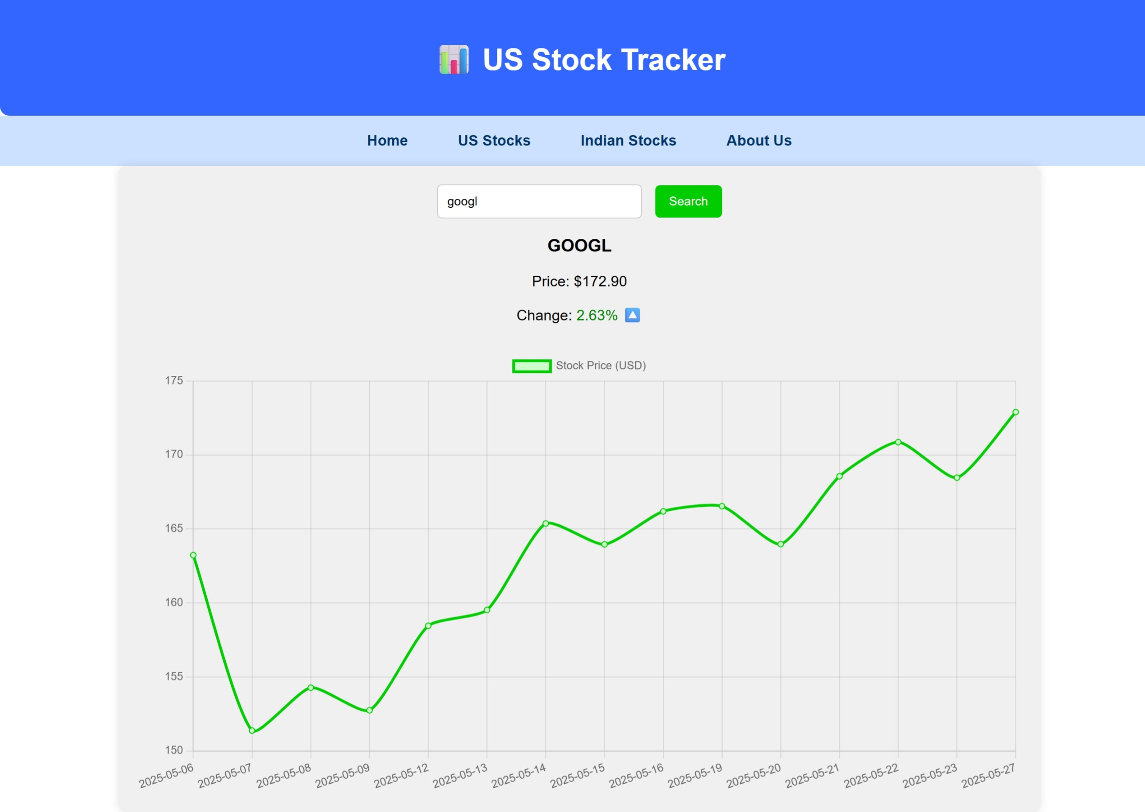

Slide 9
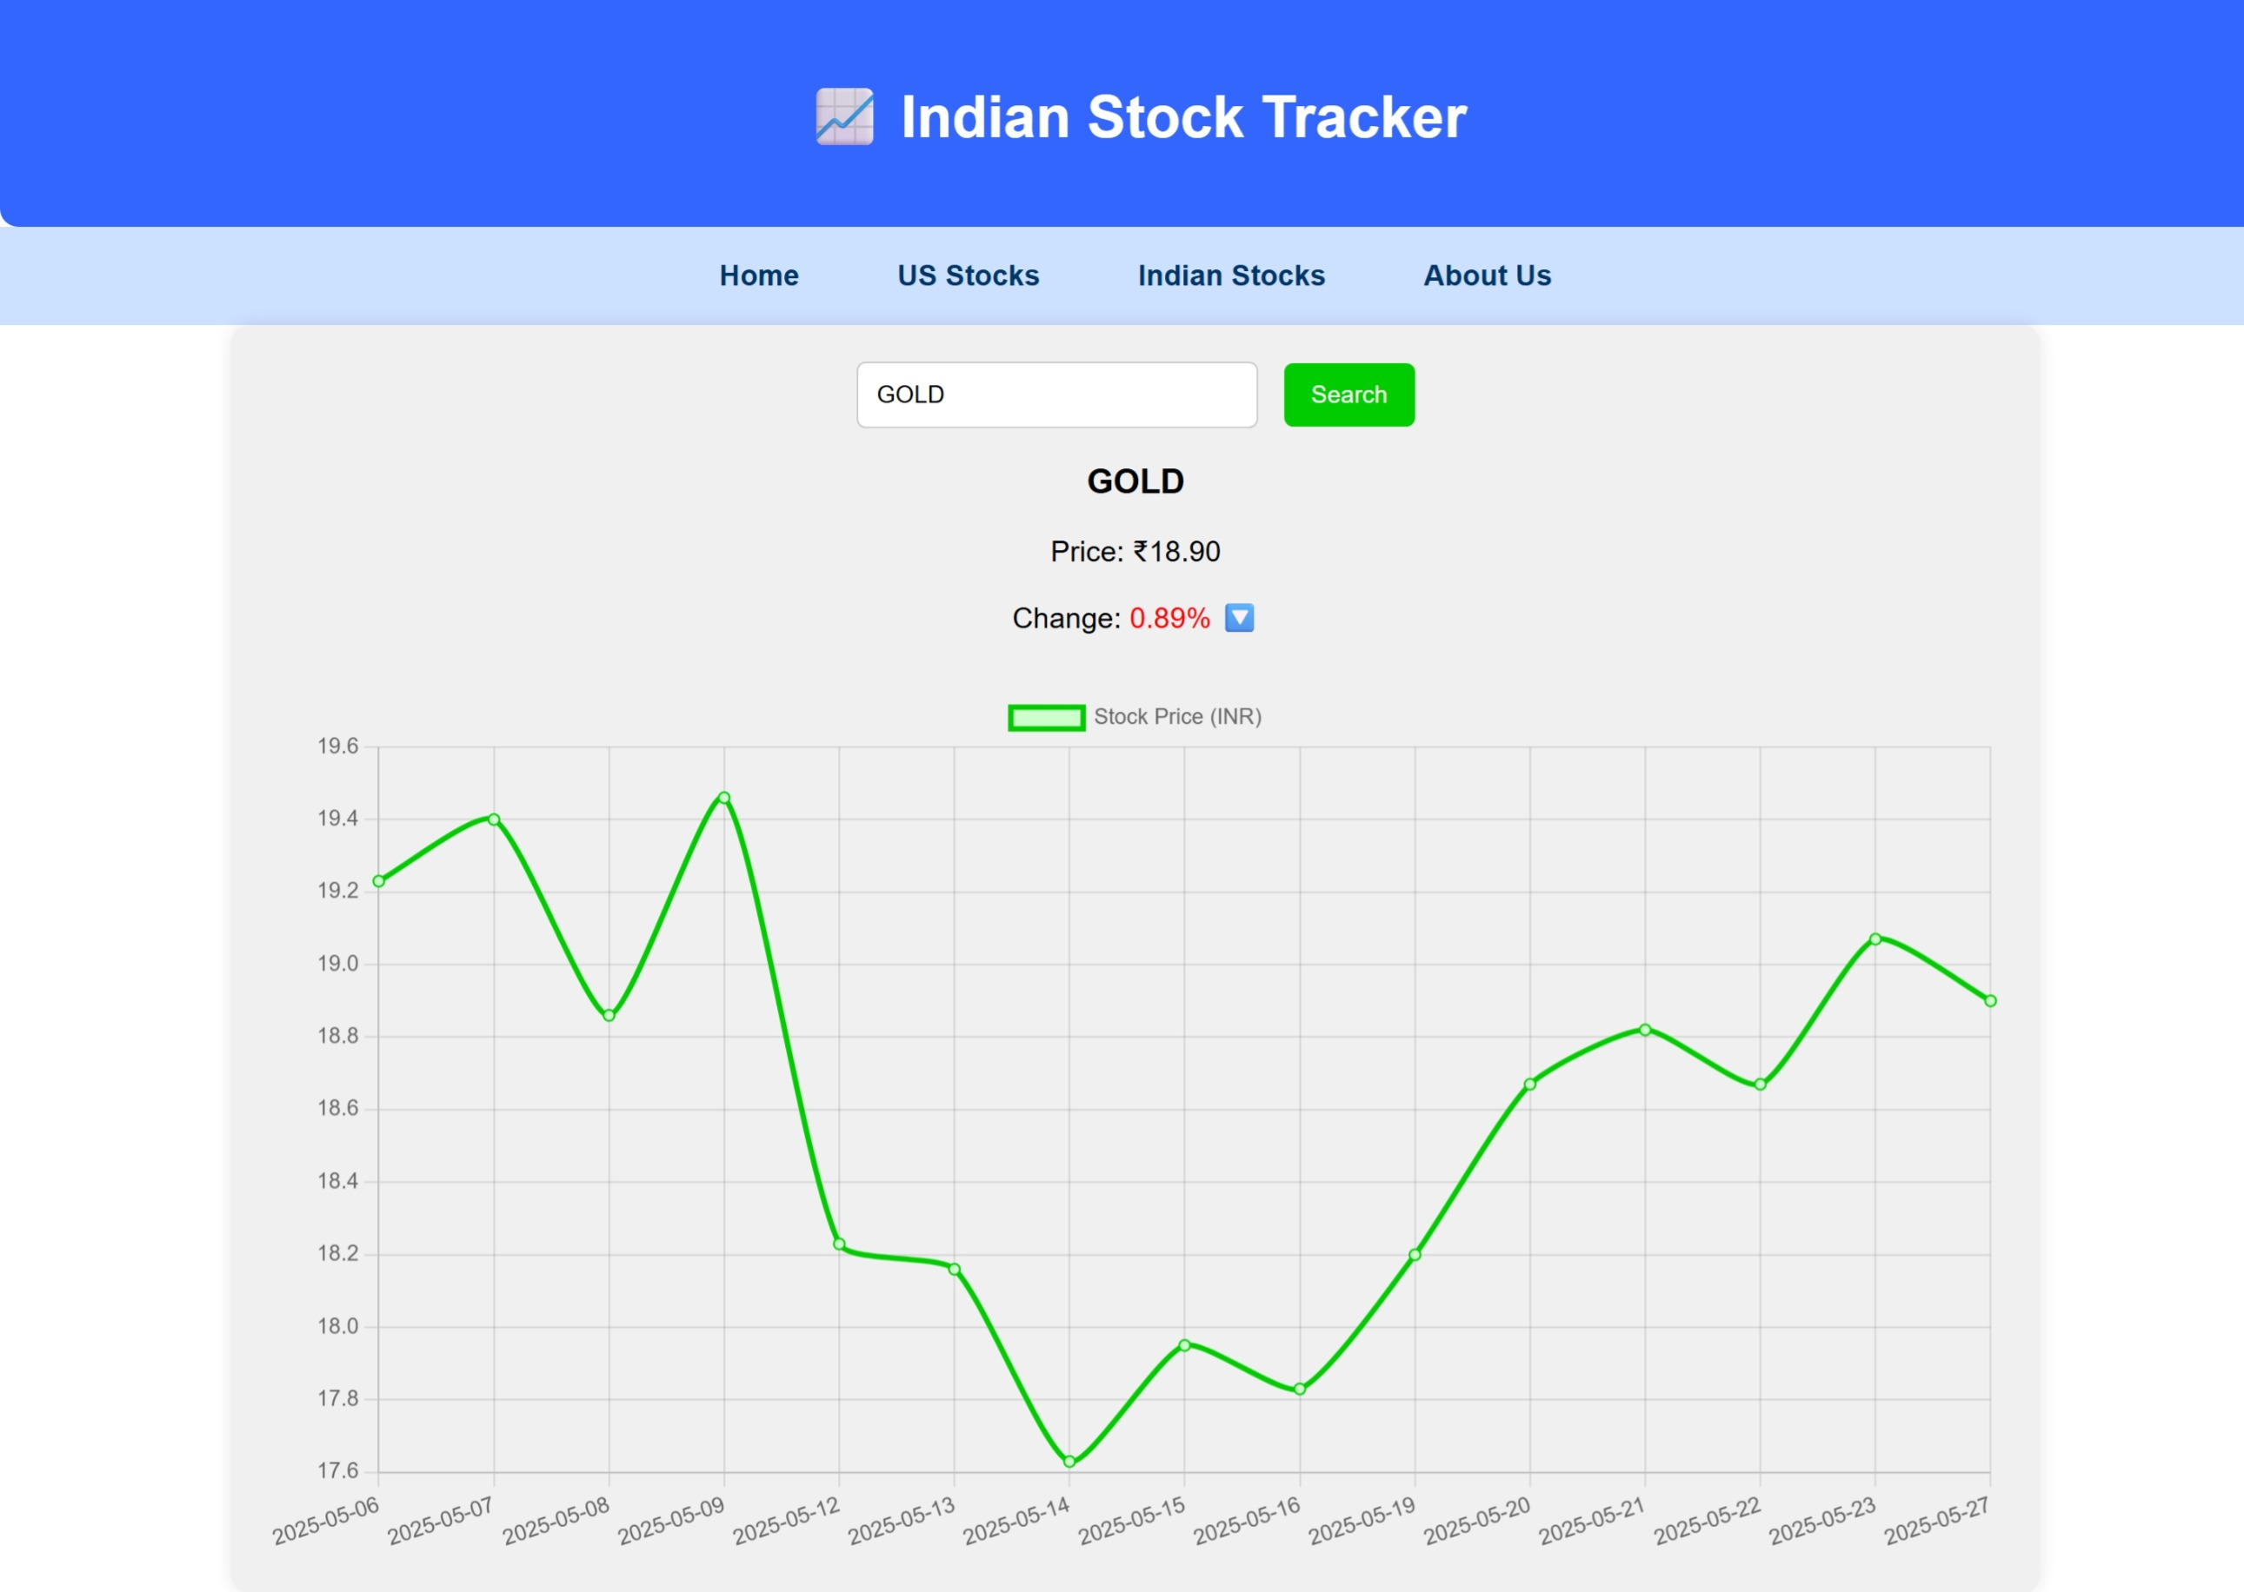

Slide 10
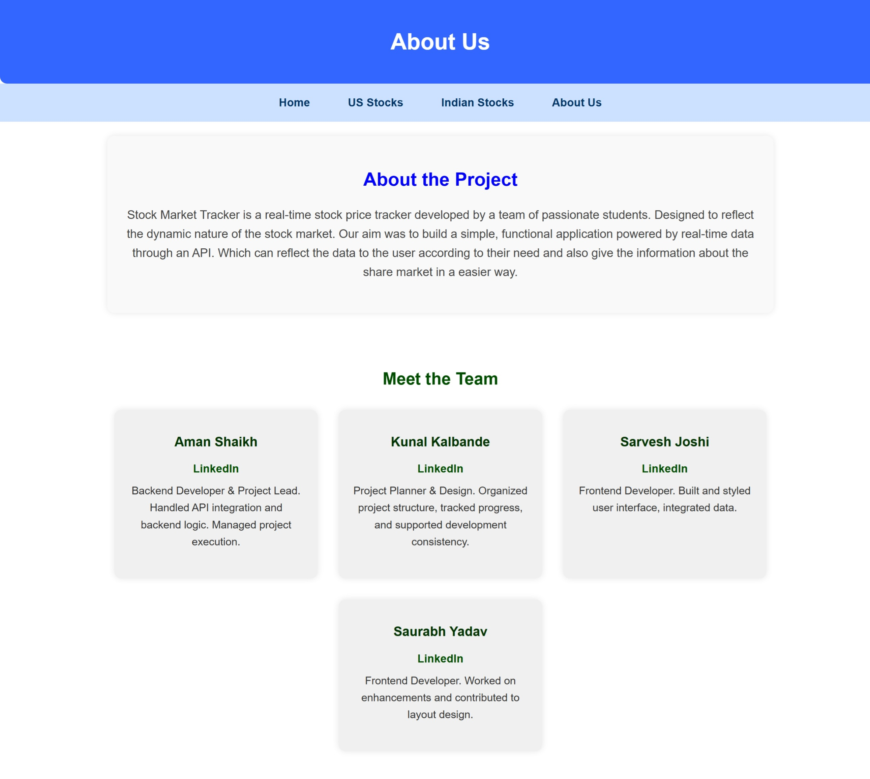

Slide 11
REAL WORLD APPLICATION​
Beginner Tool: Perfect starting point before using real trading apps.
Educational Value: Ideal for students and finance workshops.
Community Learning: Can be used in peer groups or college clubs.
Classroom Use: Helpful for practical sessions in finance courses.

Slide 12
FUTURE SCOPE
Real-Time API Integration: Add live stock market data.
User Accounts: Personalized portfolios with login/signup.
Mobile App: Expand to Android/iOS platforms.
Gamified Learning: Quizzes and rewards for engagement.
IPO & Small-Cap Tracking: Broaden investment insights.
Google Sheets Sync: Export data for custom analysis

Slide 13
Conclusion
Our Stock Price Tracker project goes beyond just displaying market data — it introduces beginners to the world of investing in a simplified, engaging, and educational way.
With its intuitive design, key features tailored for new users, and potential for future enhancements, the platform lays a strong foundation for financial literacy and informed decision-making.
As we continue to evolve it with real-time data, personalization, and mobile accessibility, this project has the potential to become a valuable tool for aspiring investors and learners everywhere.

Slide 14
THANK YOU

